Slide 1

Πρόοδος εκπαίδευσης κυβερνοασφάλειας
Pancreta Bank
February, 2025
Notes:
This slide deck contains many figures and graphs about your organization’s training. It’s built in a modular way that allows you to remove any slides that you don’t want or need to present to your managers.

Slide 2
Τελευταία περίοδος εκπαίδευσης
March 28, 2024 - June 25, 2024
Notes:
The following slides refer to the last training period, which is 3 months (or fewer, if you’re using CybeReady for less than that).

Slide 3
Τι κάναμε;
Εκπαιδεύσαμε
949
154
2
1
👤Υπάλληλοι
👤είναι νέοι
Γλώσσες
Τοποθεσίες
Δεδομένα και αριθμοί
2,312
11,814
Απεσταλμένες προσομοιώσεις
Σύντομο περιεχόμενο ευαισθητοποίησης που απεστάλη
Notes:
This slide summarizes some figures about the employees training in your organization.

Slide 4
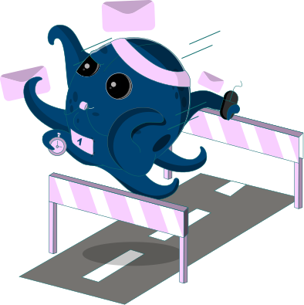


Ταξινόμηση συμπεριφοράς υπαλλήλων
#1
Evader
#2
Evader + Learner
#3
Learner
Notes:
This chart shows the distribution of behavior types across your organization, sorted from the largest group to the smallest.
If you have Employee Scorecards enabled, then this is the avatar they will receive.

Slide 5
Ηλεκτρονικό «ψάρεμα»
13.3%
9.0%
Μέσο ποσοστό κλικ
Υπάλληλοι υψηλού κινδύνου
+3.8%
σε σύγκριση με την προηγούμενη περίοδο
+8.3%
σε σύγκριση με την προηγούμενη περίοδο
13.7%
Μέσο ποσοστό κλικ από νέους υπαλλήλους
+4.2%
σε σύγκριση με την προηγούμενη περίοδο
Notes:
These metrics that show how strong your organization is against phishing.

Slide 6
Σύντομο περιεχόμενο ευαισθητοποίησης
53.8%
21.7%
Μέσο ποσοστό ανοίγματος
Ποσοστό απάντησης κουίζ
+22.1%
σε σύγκριση με την προηγούμενη περίοδο
-1.2%
σε σύγκριση με την προηγούμενη περίοδο
0.0%
Αθροιστικό ποσοστό ανοίγματος
Notes:
These metrics show how well your organization is training towards security awareness.

Slide 7
Τρωτότητα ανά τμήμα
March 28, 2024 - June 25, 2024
Notes:
The following slides examine departments in your organization that should be closely monitored or need extra training.

Slide 8
Πιο ευάλωτα τμήματα
Ποσοστό κλικ
Notes:
This graph shows the most vulnerable departments in terms of click rate: number of clicks divided by the number of simulations sent to employees in that department.

Slide 9
Πιο ευάλωτα τμήματα
Αριθμός κλικ
Notes:
This graph shows the most vulnerable departments by number of phishing simulations clicks.
Even if a department has a low click rate on average, each click is still a vulnerability in your organization. You might also want to make sure that those departments don’t have access to sensitive data.

Slide 10
Τμήματα σε αυξανόμενο κίνδυνο
Αύξηση ποσοστού κλικ σε σύγκριση με την προηγούμενη περίοδο
Notes:
This graph shows the departments whose click rate grew the most, compared to the previous training period. While some of them may not be the most vulnerable departments at the moment, they are worth monitoring.

Slide 11
Αξιοσημείωτα παραδείγματα εκπαίδευσης
March 28, 2024 - June 25, 2024

Slide 12

Προσομοίωση με τα περισσότερα κλικ από νέους υπαλλήλους
Από: Τμήμα Ανθρωπίνου Δυναμικού <hr@notification.apponline.info>
Θέμα: Οδηγίες μετακόμισης στο νέο γραφείο για όλους τους υπαλλήλους
Αναλογία κλικ προς αριθμό εμφανίσεων
26.1%
Notes:
This simulation had the highest click rate within new employees in your organization.
New employees are ones who received 6 or fewer phishing simulations.

Slide 13
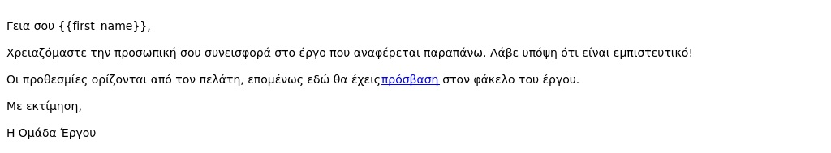
Προσομοίωση με τα λιγότερα κλικ από το σύνολο των υπαλλήλων
Από: Ομάδα έργου <ergo@notifytechs.com>
Θέμα: Η Εξέταση του Έργου της Ομάδας μου
Αναλογία κλικ προς αριθμό εμφανίσεων
1.3%
Notes:
This simulation had the lowest click rate in your entire organization.

Slide 14
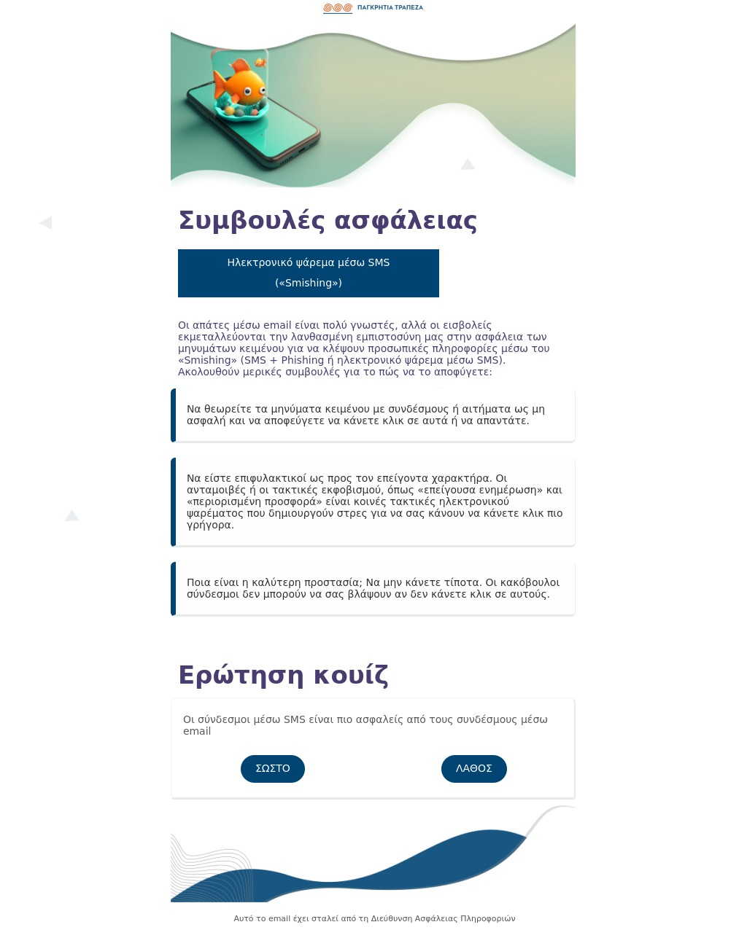
Σύντομο περιεχόμενο ευαισθητοποίησης με περισσότερα ανοίγματα
Θέμα: Οι εισβολείς *ΛΑΤΡΕΥΟΥΝ* τα μηνύματα κειμένου. Τι μπορείτε να κάνετε;
Ποσοστό ανοίγματος
30.9%
Notes:
This Awareness Bite had the highest open rate in your entire organization.

Slide 15
Μακροπρόθεσμη ανάλυση
December 19, 2023 - June 25, 2024
Notes:
The following slides refer to the last 12 months of training.

Slide 16
Αποτελεσματικότητα εκπαίδευσης
Μεταβολή βαθμού κινδύνου ηλεκτρονικού «ψαρέματος»
Ποσοστό ανοίγματος σύντομου περιεχομένου ευαισθητοποίησης
-4.4%
53.8%
-43.4%
Notes:
This slide shows the training effectiveness across the CybeReady products you have activated.
Phishing Risk Score: Each employee in the organization is assigned a risk score, based on their clicks in phishing simulations. The graph shows the change in risk from the beginning of training until today. Lower is better.
PhishCage Reporting Rate: The percentage of employees who have reported a suspicious email. Higher is better.
Awareness Bites Open Rate: The percentage of employees who have opened at least one Awareness Bite. Higher is better.

Slide 17
Τάση υπαλλήλων υψηλού κινδύνου
Notes:
The top graph shows the percentage of employees in your organization who are classified as “High Risk”.
The bottom graph shows the number of employees in your organization. If you see big changes in the top graph, they might be explained by big changes in the size of the company (like employee turnover or a hiring spree).
The graphs are aligned, so you can easily find correlations if necessary.

Slide 18
Αναλογία κλικ προς αριθμό εμφανίσεων
Notes:
This graph shows your organization’s click rate against the benchmark.
The benchmark is calculated using data from other organizations who received the same simulations as you.

Slide 19
Ταξινόμηση οργανισμού ανά ομάδα κινδύνου
Notes:
This graph shows the percentage of each risk group in your organization, over time. The sum is always 100%.
Ideally, you’d want the High Risk group to be as small as possible, and the Low Risk to be as big as possible.
When new employees join, they are initially assigned to the average risk group of the organization.

Slide 20
Νέοι vs. βετεράνοι υπάλληλοι
Notes:
The top graph shows the difference in phishing resilience between new and veteran employees. All employees are considered “New” until they receive at least 7 phishing simulations, at which point they become “Veterans”.
It’s normal to see the New Employees line above the Veterans line, since they haven’t received as much training.
The bottom graph shows the number of employees in each seniority group. You can use this to explain things if you see any big changes in the top graph.

Slide 21
Ποσοστό ανοίγματος
Notes:
This graph shows how employees in your organization interact with Awareness bites.
The solid line shows the percentage of bites that were opened (out of all sent bites) in each campaign.
The dotted line shows the percentage of employees who opened at least one Awareness Bite during their training.

Slide 22
Περίληψη σύντομου περιεχομένου ευαισθητοποίησης
Notes:
This graph shows how many Awareness Bites we sent and how many were opened in comparison.

Slide 23
Ποσοστό απάντησης
Notes:
This graph shows how employees in your organization interact with Awareness bites.
The main line shows the percentage of quizzes (in the bites) that were answered by employees.
The other line shows the percentage of employees who answered at least one Awareness Bite quiz during their training.

Slide 24
Ταξινόμηση οργανισμού ανά ομάδα αλληλεπίδρασης
Notes:
This graph shows the percentage of each engagement group in your organization, over time. The sum is always 100%.
Ideally, you’d want the High Engagement group to be as big as possible, and the Low Engagement to be as small as possible.
New employees always start as Medium Engagement.

